Slide 1
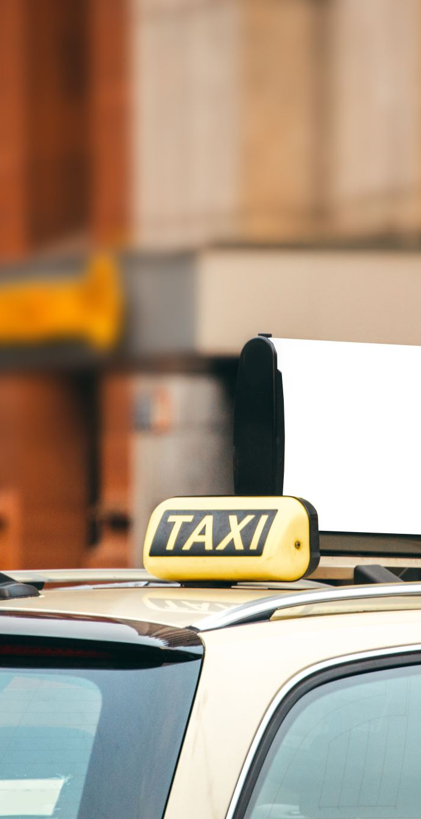
LPU – taxi BOOKING SYSTEM USING J FRAMES
SUBMITTED BY-
RITIKA WADHWA 12106292

Slide 2
INTRODUCTION-
In this java project we developed a simple GUI- based cab booking system allow user to book a cab to reach their destination inside the LPU campus.
Our cab booking system supports a range of users inside the LPU , they can book the cab . The fair charge depends on their destination .
Overall it provides a solution to the users whose classes are very far from main gate they can book cab online via our system at any time.

Slide 3
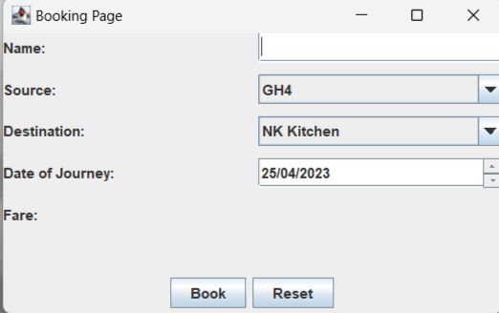
DEMO OF PROJECT-
This is how our page looks like before GUI. This page is made from text fields , J buttons, menu buttons etc. here user have to enter the name source and destination and date of journey. And then click on book button.

Slide 4
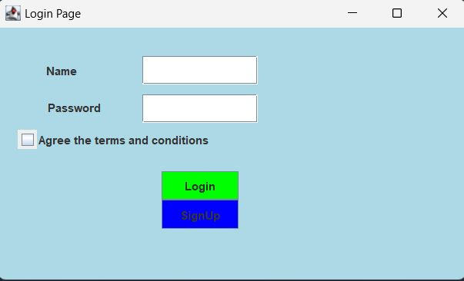
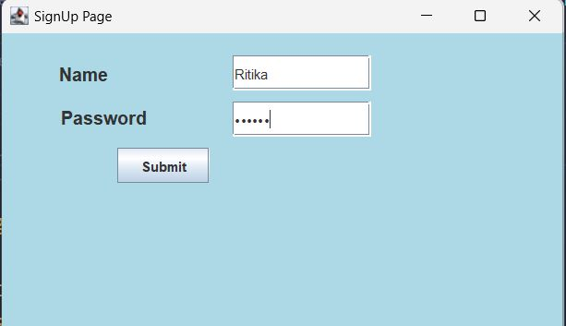
Demo of login page and signup page-

Slide 5
Proposed technique
Some of the packages used in this project are as:
Java Swing Library: This library provide classes and interfaces for creating graphical user interfaces (GUIs) in Java, Inside this library there are many modules used in this project. Some of them are listed below as:
JFrame: This module is used to create a basic window that can hold other GUI components and , such as buttons, text fields, and labels.
JPanel: This module is used to create a container for other components that can be added to a JFrame. A JPanel can be used to group related components.
Java.awt: This package is an Abstract Window Toolkit in java and it provides a powerful set of tools for creating rich, interactive GUIs in Java. However, it has been largely supplanted by the more modern Swing and JavaFX frameworks. Some of the key classes and interfaces of “java.awt” we used in this project are as:
Graphics: An abstract base class for graphics contexts, which provides methods for drawing lines, shapes, text, and images.
Colour: A class for representing colours in RGB (red, green, blue) format.
Font: A class for representing fonts, which can be used to render text in a GUI.

Slide 6
Features-
Java J Frame cab booking system boasts a range of impressive features that make it stand out from other similar systems. For example, it allows users to choose from a variety of different cab types, including standard, luxury, and SUV. Users can also specify their pick-up and drop-off locations, as well as the date and time of their journey.
Another notable feature of this system is its payment options. Users can pay The for their ride using a credit or debit card, or they can choose to pay in cash upon arrival at their destination. This flexibility makes the system accessible to a wider range of users.

Slide 7
Benefits-
One of the main benefits of the Java J Frame cab booking system is its ease of use. The user interface is intuitive and straightforward, making it easy for even inexperienced users to navigate. Additionally, the system is designed to be fast and efficient, with bookings processed quickly and accurately.
Another significant benefit of this system is its reliability. The system is built using robust, high-quality code that ensures it runs smoothly and without errors. This means that users can rely on the system to provide them with a seamless and stress-free cab booking experience.

Slide 8
Technical specifications-
The Java J Frame cab booking system is built using Java, one of the most popular programming languages in the world. It uses a Model-View-Controller (MVC) architecture, which separates the application logic from the user interface. This makes the system more modular and easier to maintain.
The system also uses a get set method to store user information and booking data. This database is secure and reliable, ensuring that user data is protected at all times. Finally, the system is designed to be scalable, meaning that it can handle a large number of users and bookings without slowing down or crashing.

Slide 9
Module description-
Home page
Login page
Services
Status
All the above pages consist of buttons and entry fields in order to generate receipts for customer.

Slide 10
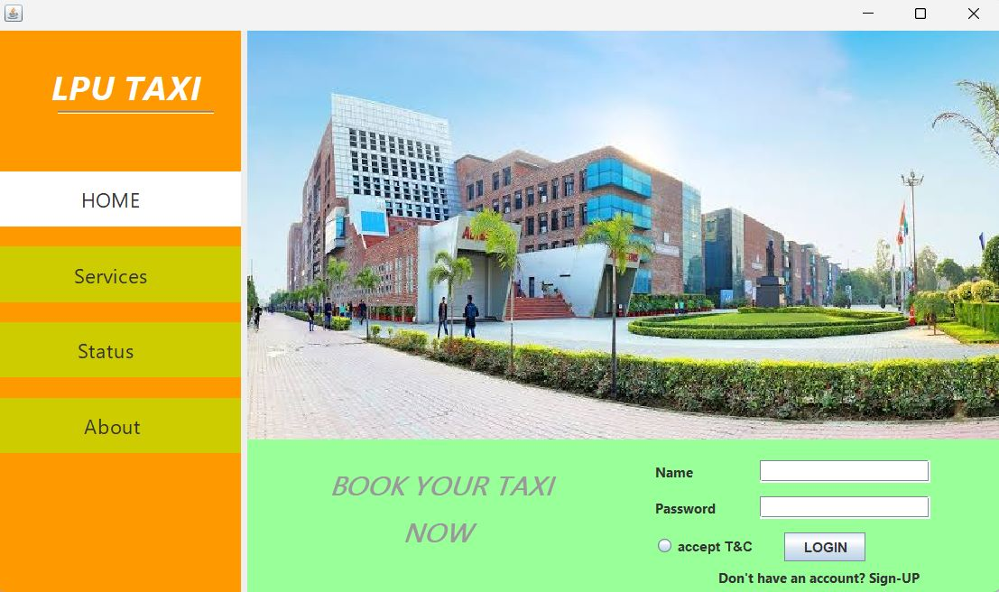
Homepage-
home page consists of text field that user need to enter Name and password and then click on button login
login page consists of text field that user need two buttons accept terms and conditions . And click on login button

Slide 11
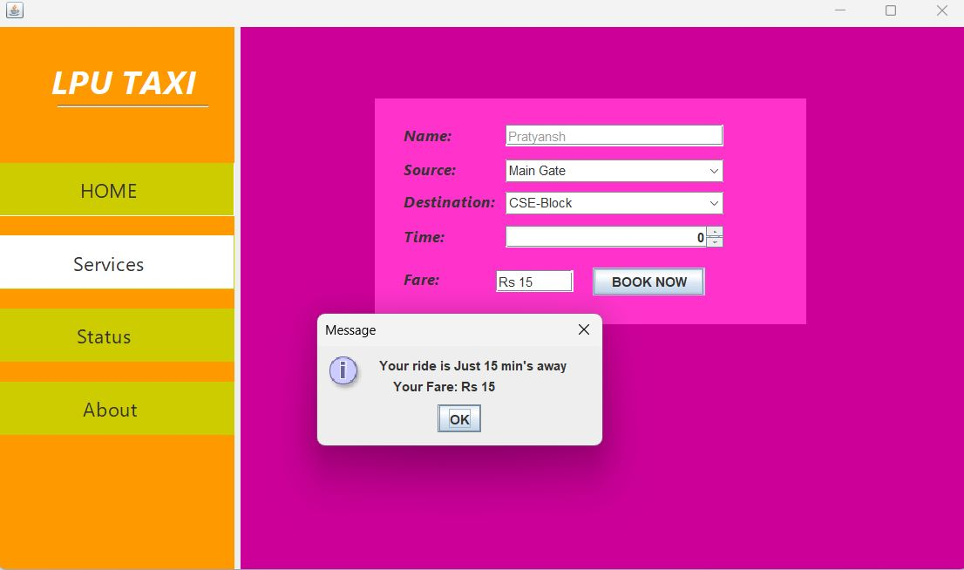
services
Here user need to enter the name, source from where user have to take taxi and enter the destination
Fair charge will automatically come according to destination
Then a button of book now is created by clicking this user can book a taxi .
Then message of conformation will appear.

Slide 12
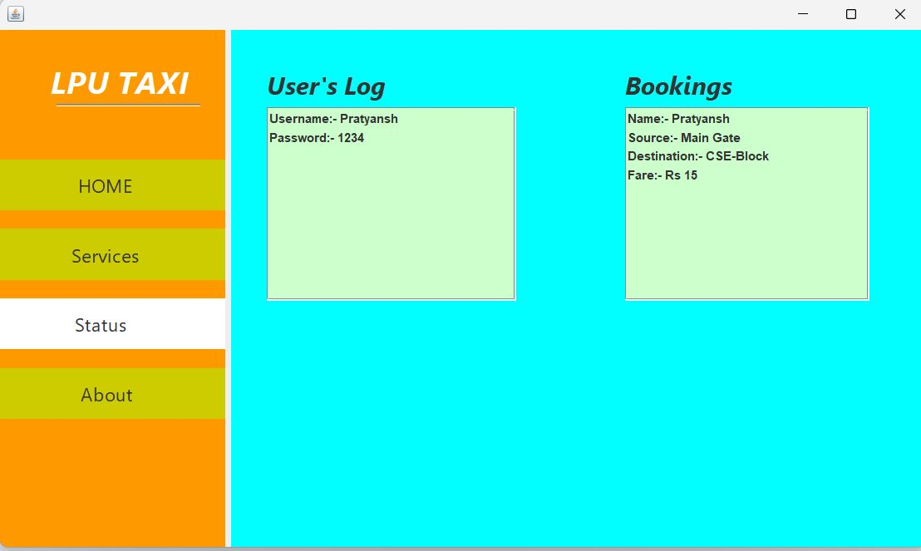
Status-
Using get set method in status page details of login and details of last booking will be accessed by user.

Slide 13
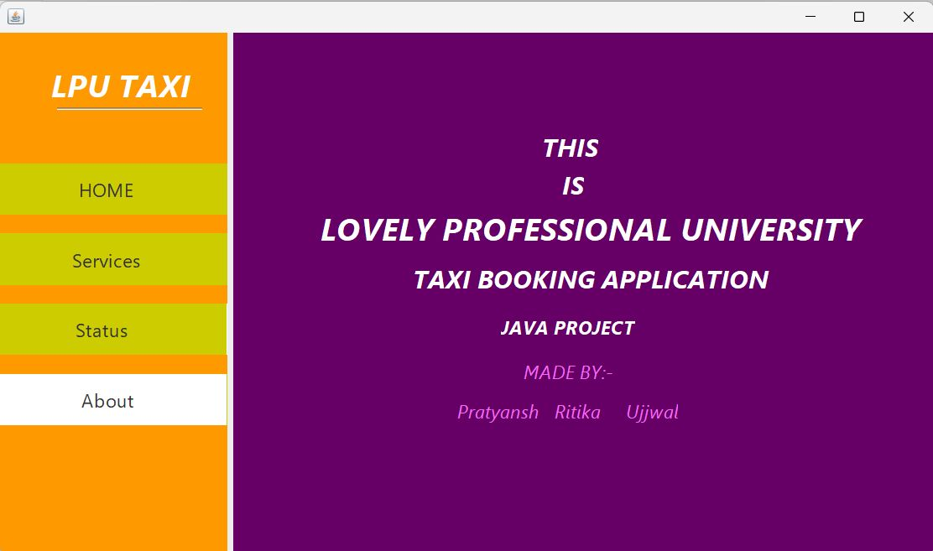
About-
This the last page of our project which consist information about this project is made by us for betterment of students and faculty members inside of LPU.

Slide 14
CONCLUSION-
In conclusion, the Java J Frame cab booking system is an excellent choice for anyone looking for a reliable, efficient, and easy-to-use cab booking system. Its range of features and benefits make it stand out from other similar systems, while its technical specifications ensure that it is secure, scalable, and robust.
Whether you are a frequent traveler or just need a ride to the airport, the Java J Frame cab booking system is the perfect solution for all your transportation needs.

